Slide 1
MSLs Cumulative Review
7th Grade Science

Slide 2
1. When the body overheats, it produces sweat to cool off. This is an example of the body trying to maintain a stable internal environment called _____.
Human Body – Day 1
Normalcy
Homeostasis
Regulating
Cooling

Slide 3
2. Which of the following is a function of the blood?
Human Body – Day 1
Transports nutrients and other substances to body cells
Carries saliva to the mouth
Helps the joints move smoothly
Transmits nerve signals to the cells

Slide 4
3. After eating a slice of pizza, which path will the food take through your digestive system?
Human Body – Day 1
Stomach, esophagus, small intestine, large intestine
Stomach, small intestine, large intestine, esophagus
Esophagus, stomach, large intestine, small intestine
Esophagus, stomach, small intestine, large intestine

Slide 5
4. Which of the following is NOT a function of the digestive system?
Human Body – Day 1
Transports nerve signals
Absorbs oxygen
Absorbs nutrients
Transports nutrients

Slide 6
5. Which of the following is TRUE about blood?
Human Body – Day 1
Blood both carries oxygen to cells and carries carbon dioxide away from cells.
Blood carries oxygen to cells but does not carry carbon dioxide away from cells.
Blood carries carbon dioxide away from cells but does not carry oxygen to cells.
Blood does not carry oxygen to cells and does not carry carbon dioxide away from cells.

Slide 7
Constructed Response
Human Body – Day 2
Pick two body systems that we have studied this year and explain how they work together to complete a job. Make sure to use appropriate vocabulary.

Slide 8
1. How do simple sugars, oxygen, and other molecules that are needed by cells of the body enter and exit the circulatory system?
Human Body – Day 3
Needed molecules pass through the walls of blood vessels of any size.
Needed molecules pass only through the walls of large blood vessels such as arteries and veins.
Needed molecules pass only through the walls of microscopically small blood vessels (capillaries).
Needed molecules do not pass through the walls of any blood vessels.

Slide 9
2. During digestion, what happens to the protein, complex carbohydrate, and fat molecules in food?
Human Body – Day 3
They are broken down into other protein, complex carbohydrate, and fat molecules.
They are broken down into carbon dioxide and water.
They are broken down into smaller molecules (subunits).
Nothing happens to them. Other molecules are broken down during digestion but not protein, complex carbohydrate, or fat molecules.

Slide 10
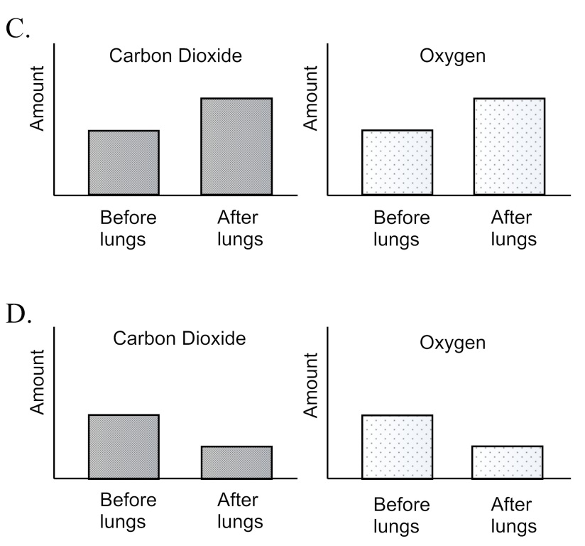
3. A person measures the levels of carbon dioxide and oxygen in the blood before and after the blood passes through the lungs. Which of the following pairs of graphs shows the changes in carbon dioxide and the changes in oxygen in the blood before and after passing through blood vessels in the lungs?
Human Body – Day 3

Slide 11
4. Each of the following organs help remove waste products from the body and make up which system? Liver, Kidney, Skin, Lungs
Human Body – Day 3
Digestive
Respiratory
Excretory
Integumentary

Slide 12
5. Asthma is a medical condition that results in a problem with the respiratory system, what might happen in a person suffering from asthma?
Human Body – Day 3
Less oxygen entering the bloodstream
More oxygen entering the bloodstream
Less protein in the urine
More calcium in the bones

Slide 13
Constructed Response
Human Body – Day 4
Compare and contrast the activities and jobs of the small and large intestines during digestions. Make sure to use appropriate vocabulary.

Slide 14
1. Fertilization occurs when…
Human Body – Day 5
A female releases an egg from the ovary
A female experiences her menstrual cycle
A male releases sperm from the testes
A sperm unites with an egg during intercourse

Slide 15
2. How does mechanical digestion help us process food?
Human Body – Day 5
It breaks food down into other substances
It transfers food to different organs
It stores food until we are ready for it
It breaks food down into smaller pieces

Slide 16
3. How does chemical digestion help us process food?
Human Body – Day 5
It breaks food down into other substances
It transfers food to different organs
It stores food until we are ready for it
It breaks food down into smaller pieces

Slide 17
4. During cellular respiration, your body uses which of the following to create energy for the cells?
Human Body – Day 5
Oxygen and salt
Carbon dioxide and water
Oxygen and carbon dioxide
Oxygen and glucose

Slide 18
5. Which of the following could result if a fertilized cells fails to completely split apart?
Human Body – Day 5
Identical twins
Fraternal twins
Triplets
Conjoined twins

Slide 19
Constructed Response
Human Body – Day 6
Create a Venn diagram that compares and contrasts the arteries and veins. Make sure to use appropriate vocabulary. You should have at least 2 facts in each section.

Slide 20
1. One symptom of illness is having a larger than normal number of blood cells. Which type of blood cell might the doctor look for?
Human Body – Day 7
Plasma
Platelet
White
Red

Slide 21
2. Hiccups cause your regular breathing to be disrupted. What body part is responsible for changes in breathing?
Human Body – Day 7
The ribs
The alveoli
The larynx
The diaphragm

Slide 22
3. Having too much water in the blood can be dangerous for the heart. What organ might not be working properly if you have too much water in the blood?
Human Body – Day 7
Heart
Stomach
Liver
Kidney

Slide 23
4. A broken or clogged blood vessel in the brain can lead to death because brain cells stop getting oxygen and cannot get rid of carbon dioxide. What is this condition where blood flow to the brain has stopped?
Human Body – Day 7
Heart attack
Seizure
Stroke
Amnesia

Slide 24
5. What is the structure and location of the capillaries?
Human Body – Day 7
Thin-walled and carry blood away from heart
Thin-walled and carry blood between arteries and veins
Thick-walled and carry blood back to heart
Valves that move blood inside the heart

Slide 25
Constructed Response
Human Body – Day 8
Explain how the lungs move air in and out of the body. Make sure to explain the roles of the diaphragm and the alveoli.

