Slide 1
MSLs Cumulative Review
7th Grade Science

Slide 2
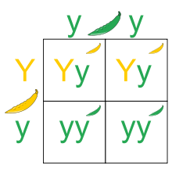
1. What percent of the following offspring will show the recessive trait?
Heredity Genetics – Day 1
0%
25%
50%
75%

Slide 3
2. Which of the following genotypes are considered hybrid?
Heredity Genetics – Day 1
YY
Yy
yy
None of the above

Slide 4
3. Which of the following sets of parents produce offspring that are recessive?
Heredity Genetics – Day 1
RR x Rr
Rr x RR
Rr x Rr
RR x rr

Slide 5
4. Genes that are found on either of the sex chromosomes (X or Y) are control traits that are called __________.
Heredity Genetics – Day 1
Gender traits
Hybrid traits
Sex-linked traits
Mutated traits

Slide 6
5. Which explains why sexual reproduction produces greater variations in the offspring?
Heredity Genetics – Day 1
The DNA comes from two genetically different parents
The DNA comes from one parent that is genetically identical
The sex cells are produced by mitosis
The sex cells undergo self-fertilization

Slide 7
Constructed Response
Heredity Genetics – Day 2
Explain how offspring from the same set of parents might have a different set of traits. Make sure to use the appropriate vocabulary. You may use a Punnett square to support your answer.

Slide 8
Constructed Response
Heredity Genetics – Day 2
Explain how offspring from the same set of parents might have a different set of traits. Make sure to use the appropriate vocabulary. You may use a Punnett square to support your answer.
70 – They responded.
80 – They said that the offspring received different genes than either parent.
90 – They said that the offspring received recessive genes from a parent.
100 – They said that the offspring1 received 1 recessive gene from each parent but the parents had at least 1 dominant gene.

Slide 9
1. Like most animals, mice reproduce sexually. The skin cells of a mouse each contain 40 chromosomes. How many chromosomes does a sperm cell of a male mouse contain?
Heredity Genetics – Day 3
10
20
40
80

Slide 10
2. In sexually reproducing organisms, such as humans, which of the following statements is TRUE about the DNA found in the cells of the children?
Heredity Genetics – Day 3
A little less than 50% of a son’s body cells contain some DNA from his mother.
50% of a son’s body cells contain some DNA from his mother.
A little more than 50% of a son’s body cells contain some DNA from his mother.
100% of a son’s body cells contain some DNA from his mother.

Slide 11
3. Many different types of protein molecules are made within cells of an organism such as a human. Which of the following could be influenced by the actions of those protein molecules?
Heredity Genetics – Day 3
Both a human’s physical characteristics and its behaviors
A human’s physical characteristics but not its behaviors
A human’s behaviors but not its physical characteristics
Neither a human’s physical characteristics nor its behaviors

Slide 12
4. The eye color of children often resembles the eye color of their parents. Which of the following is genetically passed from parents to children?
Heredity Genetics – Day 3
Particles of color are passed from parents to children.
Cells that become the colored part of the eye are passed from parents to children.
Molecules that contain the information that determines eye color are passed from parents to children.
Nothing having anything to do with eye color is passed from parents to children.

Slide 13
5. A cat gets into a fight, and the tips of both of its ears get torn off. If the cat has kittens later, how will this affect the shapes of its kittens’ ears?
Heredity Genetics – Day 3
All of the kittens’ ears will be missing the tips.
Some of the kittens’ ears will be missing the tips.
All of the kittens’ ears will be slightly smaller.
It will have no effect on the ears of any of the kittens.

Slide 14
Constructed Response
Heredity Genetics – Day 4
Pick one human trait and explain how it can be impacted by the environment or a person’s behaviors. Make sure to use appropriate vocabulary.

Slide 15
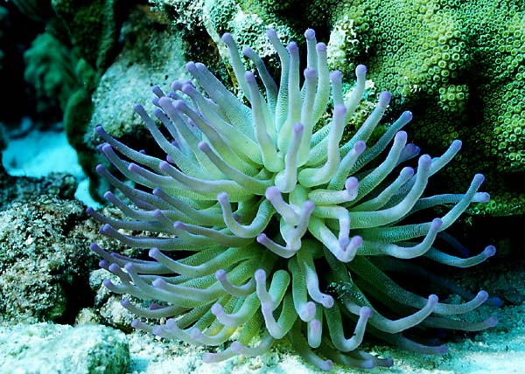
1. Sea anemones reproduce asexually by budding where one or more offspring split off from the parent. How much of the offspring’s DNA is the same as its parent’s DNA in this type of reproduction?
Heredity Genetics – Day 5
All of the DNA is the same as one parent
Half of the DNA is the same as one parent
None of the DNA is the same as its parent
Two-thirds of the DNA is the same at its parent

Slide 16
2. Hemophilia is a sex-linked recessive disorder found on the X chromosome. A male with hemophilia marries a female that is not a carrier of the disorder. If they have a male child, what are the chances that he will have hemophilia? (Hint: Use a Punnett square to figure this out.)
Heredity Genetics – Day 5
0%
50%
75%
100%

Slide 17
3. After surgery, Joe needed a blood transfusion to replace lost blood. His body will also help in healing by creating new body and blood cells through a process called __________.
Heredity Genetics – Day 5
Mitosis
Meiosis
Copying
Blooding

Slide 18
4. What causes a child to be born with Down syndrome?
Heredity Genetics – Day 5
The mother’s behavior during pregnancy.
Their genetic make-up.
Poor living conditions.
The health of the grandparents.

Slide 19
5. Xavier and his identical twin, Monroe, were separated at birth. Xavier was allowed to eat only junk food while Monroe ate a healthy diet. Xavier is now 5 inches shorter than Monroe. This evidence supports which of the following statements?
Heredity Genetics – Day 5
Human characteristics are a product of genetics and lifestyle choices.
Human characteristics are only due to genetics.
Human characteristics are only due to lifestyle choices.
Human characteristics are randomly determined and cannot be affected by our behaviors.

Slide 20
Constructed Response
Heredity Genetics – Day 6
Pick one genetic disease that we have discussed in class and provide a brief explanation. Be sure to explain how the disease affects the person’s ability to survive. Make sure to use appropriate vocabulary.
You can do this with a bulleted list, a labeled diagram or a paragraph.

Slide 21
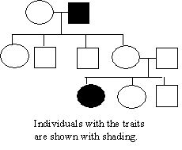
1. Look at the following pedigree. Individuals that show the phenotype for the trait are shaded in black. Carriers are NOT shown. It must be a
Heredity Genetics – Day 7
A dominant trait
A recessive trait
A deadly trait
A hybrid trait

Slide 22
2. What is the unit of heredity that determines a particular trait?
Heredity Genetics – Day 7
A phenotype
A nucleus
A chromosome
A gene

Slide 23
3. Rachel was born with wavy hair. Her mom has straight hair and her dad has curly hair. Wavy hair must be an example of
Heredity Genetics – Day 7
Complete dominance
A sex-linked trait
Incomplete dominance
A mixed trait

Slide 24
4. In order for any offspring to show a recessive trait, what must be true about the parents?
Heredity Genetics – Day 7
Both parents must carry the recessive gene
One of the parents much be pure-bred dominant for the recessive trait
Both parents must also show the same recessive trait
At least two grandparents must have the recessive trait

Slide 25
5. Which of the following characteristics is an environmental trait rather than a genetic one?
Heredity Genetics – Day 7
Red and green colorblindness
Music preference
Naturally red, curly hair
Ability to roll tongue

Slide 26
Constructed Response
Heredity Genetics – Day 8
Give a brief explanation for why there are no cures for genetic diseases.
Or, why doesn’t everybody who gets a gene for a disease end up with the disease?

