Slide 1
Cell Review Questions

Slide 2
Cell Review: Day 1
"Pseudopodia" literally means?
“False feet”
“True motion”
“False motion”
“True feet”

Slide 3
Cell Review: Day 1
What is the primary method of movement for Euglena?
Flagella
Cilia
Cytoplasmic streaming
Phagocytosis

Slide 4
Cell Review: Day 1
What is the basic unit of structure and function in a living organism?
Cell
Tissue
Organ
Organ system

Slide 5
Cell Review: Day 1
Several types of tissue that work together to perform a bodily function is a(n)
Organelle
Cell
Organ
Organ system

Slide 6
Cell Review: Day 1
The outer portion of an plant cell, used for protection is called the . . .
cytoplasm - the fluid portion of the cell that the organelles float in
cell membrane - a semi-permeable lipid bi-layer
nucleus - the “control center” of the cell
cell wall – a rigid outer layer made of cellulose

Slide 7
Cell Review: Day 1 ANSWERS
"Pseudopodia" literally means?
“False feet” c) “False motion”
“True motion” d) “True feet”
What is the primary method of movement for Euglena?
Flagella c) Cytoplasmic streaming
Cilia d) Phagocytosis
What is the basic unit of structure and function in a living organism?
Cell c) Organ
Tissue d) Organ system
Several types of tissue that work together to perform a bodily function is a(n)
Organelle c) Organ
Cell d) Organ system
The outer portion of an plant cell, used for protection is called the . . .
cytoplasm - the fluid portion of the cell that the organelles float in
cell membrane - a semi-permeable lipid bi-layer
nucleus - the “control center” of the cell
cell wall – a rigid outer layer made of cellulose

Slide 8
Cell Review: Day 2
Match the following statements with one of the following words; fill in the space with the letter of the correct word.
(A) Mitochondria (E) Cell wall
(B) Nucleus (F) Golgi apparatus
(C) Endoplasmic reticulum (G) Nuclear membrane
(D) Ribosome (I) Cell membrane
The part of a cell that allows the transportation of materials throughout the cytoplasm.
The organelle of the cell that contains chromosomes and controls all cell functions.
The part of the cell that controls movement of materials into and out of the cell.
This structure packages and stores protein.
A “wood like” boundary that plant cells use for support and protection.
The “skin” which allows certain materials to pass in and out of the nucleus.
The site of protein synthesis (where proteins are made).
Where glucose and oxygen undergo cellular respiration to produce ATP or energy

Slide 9
Cell Review: Day 2 ANSWERS
Match the following statements with one of the following words; fill in the space with the letter of the correct word.
(A) Mitochondria (E) Cell wall
(B) Nucleus (F) Golgi apparatus
(C) Endoplasmic reticulum (G) Nuclear membrane
(D) Ribosome (I) Cell membrane
The part of a cell that allows the transportation of materials throughout the cytoplasm. ( C )
The organelle of the cell that contains chromosomes and controls all cell functions. ( B )
The part of the cell that controls movement of materials into and out of the cell. ( I )
This structure packages and stores protein. ( F )
A “wood like” boundary that plant cells use for support and protection. ( E )
The “skin” which allows certain materials to pass in and out of the nucleus. ( G )
The site of protein synthesis (where proteins are made). ( A )
Where glucose and oxygen undergo cellular respiration to produce ATP or energy. (D)

Slide 10
Cell Review: Day 3
Where is energy produced in the cell?
endoplasmic reticulum
mitochondria
lysosomes
nucleus

Slide 11
Cell Review: Day 3
The structure surrounding all cells that regulates what enters and leaves is called the. . .
cytoplasm
cell wall
cell membrane
nuclear membrane

Slide 12
Cell Review: Day 3
Which of the following is a list of organelles that are only found in plant cells?
nucleus, cytoplasm, ribosomes
cell wall, chloroplasts, one large vacuole
lysosomes, cell membrane, mitochondria
vacuoles, chloroplasts, nucleus

Slide 13
Cell Review: Day 3
What is the protein packaging and storing organelle of the cell called?
mitochondria
Golgi apparatus
endoplasmic reticulum
centriole

Slide 14
Cell Review: Day 3
The main function of the cell wall is to . . .
provide structure and support
store waste
provide energy
make ribosomes

Slide 15
Cell Review: Day 3 ANSWERS
Where is energy produced in the cell?
endoplasmic reticulum c) lysosomes
mitochondria d) nucleus
The structure surrounding all cells that regulates what enters and leaves is called the. . .
cytoplasm c) cell membrane
cell wall d) nuclear membrane
Which of the following is a list of organelles that are only found in plant cells?
nucleus, cytoplasm, ribosomes
cell wall, chloroplasts, one large vacuole
lysosomes, cell membrane, mitochondria
vacuoles, chloroplasts, nucleus
What is the protein packaging and storing organelle of the cell called?
mitochondria c) endoplasmic reticulum
Golgi apparatus d) centriole
The main function of the cell wall is to . . .
provide structure and support c) provide energy
store waste d) make ribosomes

Slide 16
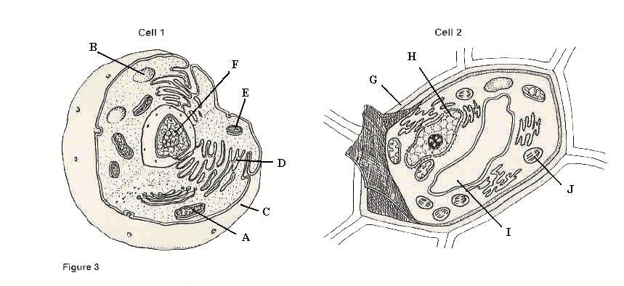
Cell Review: Day 4
Label structures A through J of Cell 1 and Cell 2 by using the word bank provided:
cell membrane
lysosomes
nucleus
Golgi apparatus
ribosomes
nucleolus
smooth endoplasmic reticulum
cell wall
cytoplasm
mitochondria
chloroplasts
vacuole
A =
B =
C =
D =
E =
F =
G =
H =
I =
J =

Slide 17
Cell Review: Day 4 ANSWERS
Label structures A through J of Cell 1 and Cell 2 by using the word bank provided:
cell membrane
lysosomes
nucleus
Golgi apparatus
ribosomes
nucleolus
smooth endoplasmic reticulum
cell wall
cytoplasm
mitochondria
chloroplasts
vacuole
A = mitochondria
B = vacuole
C = cell membrane
D = smooth endoplasmic reticulum
E = lysosomes
F = nucleolus
G = cell wall
H = nucleus
I = vacuole
J = chloroplasts

Slide 18
Cell Review: Day 5
Mitosis is a process by which . . .
toes become diseased
muscles become striated
cells die
a cell divides

Slide 19
Cell Review: Day 5
Which list shows the five (5) levels of organization in the correct order?
organ, cell, tissue, organ system, organism
cell, organ, tissue, organ, organism
cell, tissue, organ, organ system, organism
organism, cell, organ system, tissue, organ

Slide 20
Cell Review: Day 5
Read each statement carefully, if the statement is true, write the whole word TRUE in the space provided, if it is false write the whole word FALSE.
Lysosomes contain digestive enzymes and break down food.
Ribosomes are the protein-making sites of the cell.
The nucleus of a cell contains mitochondria.

Slide 21
Cell Review: Day 5 ANSWERS
Mitosis is a process by which . . .
toes become diseased c) cells die
muscles become striated d) a cell divides
Which list shows the five (5) levels of organization in the correct order?
organ, cell, tissue, organ system, organism
cell, organ, tissue, organ, organism
cell, tissue, organ, organ system, organism
organism, cell, organ system, tissue, organ
Read each statement carefully, if the statement is true, write the whole word TRUE in the space provided, if it is false write the whole word FALSE.
Lysosomes contain digestive enzymes and break down food. TRUE
Ribosomes are the protein-making sites of the cell. TRUE
The nucleus of a cell contains mitochondria. FALSE

Slide 22
Cell Review: Day 6 ANSWERS
ANIMAL – round shape, there is NO cell wall, MANY small vacuoles, and NO chloroplasts
PLANT – rectangular shape, there IS a cell wall, ONE large vacuole, and chloroplasts

Slide 23
Cell Review: Day 7
Read each statement carefully, if the statement is true, write the whole word TRUE in the space provided, if it is false write the whole word FALSE.
Animal cells have a cell wall and chloroplasts.
The endoplasmic reticulum is the control center of the cell.
DNA is found everywhere in the cell.

Slide 24
Cell Review: Day 7
Read each statement carefully, if the statement is true, write the whole word TRUE in the space provided, if it is false write the whole word FALSE.
Food and oxygen are converted to energy in the Golgi apparatus.
A cell is the smallest unit that can carry on all of the processes of life.
New cells are constantly being formed in plants and animals.
Robert Hooke observed cork cells under a microscope.

Slide 25
Cell Review: Day 7
Read each statement carefully, if the statement is true, write the whole word TRUE in the space provided, if it is false write the whole word FALSE.
Animal cells have a cell wall and chloroplasts. TRUE
The endoplasmic reticulum is the control center of the cell. FALSE
DNA is found everywhere in the cell. FALSE
Food and oxygen are converted to energy in the Golgi apparatus. FALSE
A cell is the smallest unit that can carry on all of the processes of life. TRUE
New cells are constantly being formed in plants and animals. TRUE
Robert Hooke observed cork cells under a microscope. TRUE

Slide 26
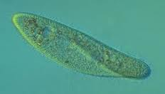
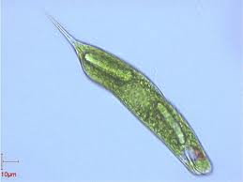
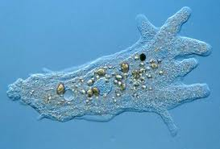
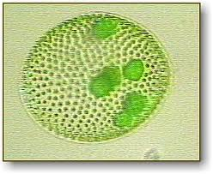
Cell Review: Day 5
Match the following pictures AND identify the special feature of the protozoa.
Paramecium
Volvox
Euglena
Amoeba
Pseudopod
Flagellum
Cilia
Colony
Y
W
X
Z

Slide 27
Cell Review: Day 8 ANSWERS
Match the following pictures AND identify the special feature of the protozoa.
Paramecium Y, C
Volvox X, D
Euglena Z, B
Amoeba W, A
Pseudopod
Flagellum
Cilia
Colony
Y
W
X
Z

Slide 28
Cell Review: Day 4 Alternate
Read each statement carefully, and write true/false. If the statement is false, rewrite the statement to make it true.
Animal cells have a cell wall and chloroplasts.
The endoplasmic reticulum is the control center of the cell.
DNA is found everywhere in the cell.
Food and oxygen are converted to energy in the Golgi apparatus.
A cell is the smallest unit that can carry on all of the processes of life.
New cells are constantly being formed in plants and animals.
Robert Hooke observed cork cells under a microscope.

Slide 29
Cell Review: Day 6 ALTERNATE
Fill in a Venn diagram comparing and contrasting MITOSIS and MEIOSIS. Try to come up with at least 3 facts in common and 3 facts each that are unique.

Slide 30
Cell Review: Day 6 ALTERNATE Answers
Fill in a Venn diagram comparing and contrasting MITOSIS and MEIOSIS. Try to come up with at least 3 facts in common and 3 facts each that are unique.
MITOSIS
MEIOSIS
Makes exact copy
Needed for growth, development, and repair
Copies full set of DNA
Occurs throughout the body
Makes a cell different from parent cell
Needed for reproduction
Divides DNA in half
Occurs in sex organs
Types of cell division
Makes new cells
Occurs in plants and animals
Copies at least some of the DNA

Slide 31
Cell Review: Day 7 ALTERNATE
Identify each statement as a description of MITOSIS (MI) or as a description of MEIOSIS (ME) or as a description of BOTH (B).
A form of cell division.
Goes through cell division twice, creating cells with ½ the number of chromosomes.
Replaces cells that have been damaged.
Binary fission in bacteria is a form of this.
Is not the same as budding.
Is necessary for reproducing offspring.
Occurs in the nucleus of the cell.
Goes through different stages of breaking apart chromosomes.

Slide 32
Cell Review: Day 7 ALTERNATE
Identify each statement as a description of MITOSIS (MI) or as a description of MEIOSIS (ME) or as a description of BOTH (B).
A form of cell division. B
Goes through cell division twice, creating cells with ½ the number of chromosomes. ME
Replaces cells that have been damaged. MI
Binary fission in bacteria is a form of this. MI
Is not the same as budding. ME
Is necessary for reproducing offspring. ME
Occurs in the nucleus of the cell. B
Goes through different stages of breaking apart chromosomes. B

Slide 33
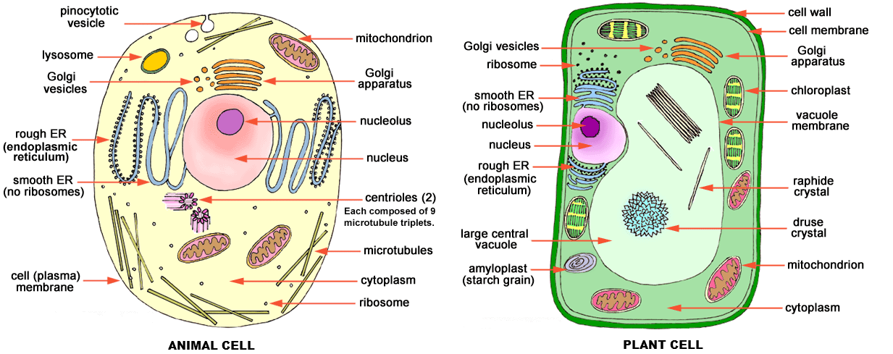
Cell Review: Day 8 ALTERNATE
Identify Cell 1 as a plant cell or an animal cell. Explain your answer.
Identify Cell 2 as a plant cell or an animal cell. Explain your answer.

