Slide 1
Cell
Division
Genetic
Diseases/
Mutations
Punnett
Squares
Heredity
Hodge
Podge
Pedigree
Charts
100
100
100
100
100
200
200
200
200
200
300
300
300
300
300
400
400
400
400
400
500
500
500
500
500

Slide 2
What is the process by which new body cells are created called?

Slide 3
Mitosis

Slide 4
Gametes are cells needed for ….

Slide 5
sexual reproduction.

Slide 6
Cell division that results in half the normal number of chromosomes is called….

Slide 7
meiosis.

Slide 8
The cells of domesticated cats have 38 chromosomes. Mitosis in cats will produce daughter cells with _____ chromosomes.

Slide 9
38

Slide 10
What is one similarity between mitosis and meiosis?

Slide 11
Meiosis and mitosis are both types of cell division.
Mitosis and meiosis both produce news cells with DNA.
Mitosis and meiosis both are needed for reproduction and growth of offspring.
Mitosis and meiosis both produce new cells in the body.

Slide 12
What is the definition of genetic disease/disorder?

Slide 13
A genetic disease/disorder is a condition caused by a gene or a mutation of a gene.

Slide 14
What do we call any permanent change in organisms DNA?

Slide 15
Mutation

Slide 16
Which genetic disease may not be present at birth but can develop during one’s lifetime as a result of environmental factors such as smoking or ultraviolet radiation?

Slide 17
Cancer

Slide 18
This condition is caused by an extra 21st chromosome and can result in abnormal physical features and mental handicaps.

Slide 19
Down syndrome

Slide 20
This genetic disorder is caused by genetic factors only, cannot be cured, affects the blood’s ability to clot, and may require transfusions.

Slide 21
Hemophilia

Slide 22
What is a Punnett square?

Slide 23
A Punnett square is a tool used to show how two parents’ genes can combine in the offspring.

Slide 24
Using the following Punnett square, what are the two phenotypes of the offspring?
T
t
T = Tall
t = Short
T
TT
Tt
t
Tt
tt

Slide 25
T
t
T
TT
Tt
Tall = 75%
Short = 25%
t
Tt
tt

Slide 26
What are the genotypes of the parents?
?
?
?
Gg
gg
?
Gg
gg

Slide 27
One parent is Gg and the other is gg.
G
g
g
Gg
gg
g
Gg
gg

Slide 28
Use this Punnett square to explain how an offspring can have a trait that neither parent has.
G
g
G
GG
Gg
g
Gg
gg

Slide 29
Both parents have a dominant gene (G) so they will show the dominant trait. However, 25% of the offspring received a recessive gene (g) from both parents and they will show the recessive trait.
G
g
G
GG
Gg
g
Gg
gg

Slide 30
This Punnett square shows the P and F₁ generations. If two F₁ offspring mate and produce offspring, what are the chances of F₂ organisms having black fur?
B = black fur
b = white fur
B
B
b
Bb
Bb
b
Bb
Bb

Slide 31
If two F₁ generation organisms produce offspring, 75% of the F₂ generation will have the dominant trait of black fur.
B
b
B
BB
Bb
b
Bb
bb

Slide 32
What are alleles? Give an example.

Slide 33
Alleles are the different forms of a trait Ex: eye color – blue, brown, hazel, green

Slide 34
Hemophilia is considered a sex-linked trait because the gene is found on the ____ or ____ chromosome.

Slide 35
Sex-linked traits are found on the X or Y chromosomes.

Slide 36
Why does sexual reproduction allow for more variety in a species?

Slide 37
Sexual reproduction involves the random combining of genes from two parents instead of just copying genes from just one parent.

Slide 38
What are the four nitrogenous bases found in DNA?

Slide 39
Adenine Thymine Cytosine Guanine

Slide 40
What are some misconceptions people have about cloning?

Slide 41
-clones will be born the age of the organism that provided the DNA -clones will behave and look just like the donor -clones will be robotic (no independent thought or emotion) -clones will be evil or monstrous -people will have to kill their clone if they need to clone their organs for medical reasons

Slide 42
What is a pedigree chart?

Slide 43
A diagram that can be used to show the inheritance pattern of a trait through two or more generations is called what?

Slide 44
What are the symbols for males and females in a pedigree chart?

Slide 45
Males are squares. Females are circles.

Slide 46
Explain the coloring on a pedigree chart.

Slide 47
No coloring = doesn’t have trait Half colored = carrier Full colored = has the trait

Slide 48
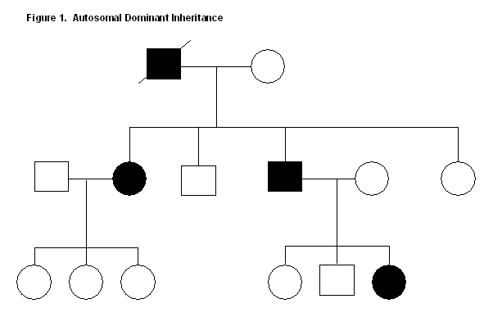
Is the trait on this pedigree dominant or recessive? Explain.

Slide 49
The trait is dominant. There are no carriers, so anyone getting one copy of the gene will show the trait.

Slide 50
What could the child of the following parents look like on the pedigree chart?

Slide 51
The child could be a carrier or not have the trait at all.
or

